Slide 1
Module 1, Section 3: AWS Infrastructure Overview
© 2018, Amazon Web Services, Inc. or its Affiliates. All rights reserved.
Notes:
Welcome to Module 1, Section 3: AWS Infrastructure Overview.

Slide 2
What’s In This Module
Part 1: AWS Global Infrastructure
Part 2: AWS Service and Service Category Overview
Notes:
In part one, we will review the AWS Global Infrastructure, and in part two we’ll provide an AWS service and service category overview.

Slide 3
Module Overview
Understand the AWS global infrastructure and the types of services that are available:
Examine the AWS global infrastructure.
Understand the difference between AWS Regions, Availability Zones (AZs), and Edge Locations.
Notes:
The goal of this module is to understand the AWS global infrastructure and the types of services that are available. We’ll examine the AWS Global Infrastructure to gain a clear understanding of what the infrastructure includes and understand the differences between AWS Regions, Availability Zones, and Edge Locations.

Slide 4
Part 1: AWS Global Infrastructure
Notes:
Introducing Part 1: AWS Global Infrastructure.

Slide 5


AWS Global Infrastructure
Applications
Virtual Desktops
Collaboration and Sharing
Databases
Analytics
App Services
Deployment and Management
Mobile Services
Cluster Computing
Queuing
Containers
Identity
Relational
Orchestration
Platform Services
Real-time
Dev/ops Tools
App Streaming
Sync
No SQL
Data Warehouse
Resource Templates
Transcoding
Mobile Analytics
Email
Usage Tracking
Caching
Data Workflows
Notifications
Search
Monitoring and Logs
Foundation
Services
Compute
(Virtual, Auto-scaling and Load Balancing)
Networking
Storage
(Object, Block and Archive)
Infrastructure
Regions
Availability Zones
Edge Locations
Notes:
As we discussed earlier, AWS provides a broad set of services, such as compute power, storage options, networking, and databases, delivered as an on-demand utility that is available in seconds, with pay-as-you-go pricing. All of these services reside on the AWS global infrastructure.
AWS’s global infrastructure can be broken down into three elements: Regions, Availability Zones, and Edge Locations.
Let’s take a more in depth look at the AWS infrastructure and see what these are.

Slide 6
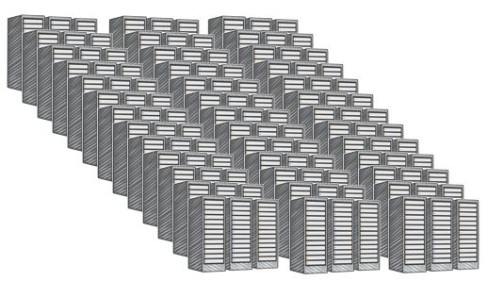
AWS Data Centers
Data centers are securely designed
A datacenter is a location where actual physical data resides
A data center typically has 50,000 to 80,000 physical servers
All data centers are online. No data center is “cold”
AWS custom network equipment:
Multi-ODM sourced
Amazon custom network protocol stack
Data center
Notes:
The foundation for the AWS infrastructure are the data centers. A data center is a location where the actual physical data resides. AWS data centers are built in clusters in various global regions.
Data centers are securely designed with several factors in mind.
Each location is carefully evaluated to mitigate environmental risk.
Data centers have a redundant design that anticipates and tolerates failure while maintaining service levels.
To ensure availability, critical system components are backed up across multiple isolated locations known as Availability Zones.
To ensure capacity, AWS continuously monitors service usage to deploy infrastructure to support availability commitments and requirements.
Data center locations are not disclosed and all access to them is restricted.
In case of failure, automated processes move customer data traffic away from the affected area.
A single data center typically houses 50,000 to 80,000 physical servers, as larger data centers are undesirable.
All data centers are online and serving customers, so no data center is “cold.”
AWS utilizes custom, multi-ODM sourced network equipment. Original Design Manufacturer (or ODM) designs and manufactures products based on specifications from a second company. The second company then rebrands the products for sale. Select the link to learn more.
https://aws.amazon.com/compliance/data-center/.

Slide 7

AWS Regions
An AWS Region is a geographical area.
Each Region is made up of two or more Availability Zones.
AWS has 18 Regions worldwide.
You enable and control data replication across Regions.
Communication between Regions uses AWS backbone network connections infrastructure.
Data center
Data center
Data center
Data center
Data center
Data center
Data center
Data center
Availability Zone
Availability Zone
Data center
Data center
Data center
Data center
Availability Zone
AWS Region
Notes:
The AWS Cloud infrastructure is built around Regions and Availability Zones.
An AWS Region is a physical geographical location in the world where we have multiple Availability Zones. To achieve fault tolerance and stability, Regions are isolated from one another. Resources in one region are not automatically replicated to other regions. Each AWS Region contains two or more Availability Zones. AWS has 18 regions worldwide.
When you store data in a specific region, it is not replicated outside that region. AWS never moves your data out of the region you put it in. It is your responsibility to replicate data across regions, if your business needs require that. AWS provides information about the country, and, where applicable, the state where each region resides. You are responsible for selecting the region to store data in, based on your compliance and network latency requirements. When you distribute applications across multiple Availability Zones, be aware of location-dependent privacy and compliance requirements, such as the EU Data Privacy Directive. When selecting a Region, it is also important to consider which region will help you optimize latency while minimizing costs and adhering to whatever regulatory requirements you may have.
Let’s dive deeper on this point. If you are leveraging cloud computing services, you can easily deploy your application in multiple regions. For instance, you can have an application in a region nearest your headquarters, such as San Diego, and then also have a deployable application in a region in the East Coast. Let’s say your largest customer base is located in Virginia. With a few clicks, you can easily deploy in the US East region to provide a better experience for your customers located there. You will be minimizing latency and increasing agility for your organization within minutes and with minimal cost.

Slide 8

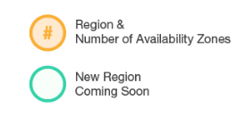
AWS Global Infrastructure: Current Regions
IRELAND
CANADA
3
BEIJING
OHIO
3
3
FRANKFURT
NINGXIA
OREGON
3
2
LONDON
3
SEOUL
3
3
PARIS
2
2
3
6
2
4
N. CALIFORNIA
1
TOKYO
N. VIRGINIA
OSAKA
AWS GOVCLOUD (US-WEST)
2
MUMBAI
3
SINGAPORE
Region & Number of AZs
3
SÃO PAULO
3
SYDNEY
Notes:
To see the regions currently available, navigate to the AWS homepage (https://aws.amazon.com) and scroll down to the global network of regions and edge locations. Edge Locations can be found by selecting the link https://aws.amazon.com/cloudfront/details/).

Slide 9

AWS Global Infrastructure: Regions Coming Soon
AWS GOVCLOUD (US-EAST)
(Coming soon)
IRELAND
SWEDEN (Coming soon)
CANADA
3
BEIJING
OHIO
3
3
FRANKFURT
NINGXIA
OREGON
3
2
LONDON
3
SEOUL
3
3
PARIS
2
2
3
6
2
4
N. CALIFORNIA
1
TOKYO
N. VIRGINIA
BAHRAIN (Coming soon)
OSAKA
AWS GOVCLOUD (US-WEST)
2
HONG KONG (Coming soon)
MUMBAI
3
SINGAPORE
Region & Number of AZs
3
SÃO PAULO
3
New Region Coming Soon
SYDNEY
Notes:
AWS products and services are available by region, so you may not see all regions available for a given service. AWS is steadily expanding its global infrastructure to help customers achieve lower latency and higher throughput, and to ensure that your data resides only in the Region you specify.
The AWS Cloud has announced plans to expand with 17 new Availability Zones in four new geographic Regions: Bahrain, Hong Kong, Sweden, and a second AWS GovCloud Region in the Eastern US.
The isolated GovCloud (US) Region is designed to allow US government agencies and customers to move sensitive workloads into the cloud by addressing their specific regulatory and compliance requirements.
For more information about global infrastructure, select the link. http://aws.amazon.com/about-aws/globalinfrastructure/

Slide 10
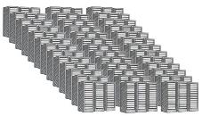
AWS Availability Zones
Each Availability Zone is:
Made up of one or more data centers.
Designed for fault isolation.
Interconnected with other Availability Zones using high-speed private links.
You choose your Availability Zones.
AWS recommends replicating across Availability Zones for resiliency.
Data Center
Data Center
Data Center
Data Center
Availability Zone
Notes:
Availability Zones consist of one or more discrete data centers designed for fault isolation, each with redundant power, networking, and connectivity housed in separate facilities. They are interconnected with other Availability Zones using high-speed private links. Some Availability Zones have as many as six data centers; however, no data center can be part of two Availability Zones.
Each Availability Zone is designed as an independent failure zone. This means that Availability Zones are physically separated within a typical metropolitan region and are located in lower-risk flood plains with specific flood-zone categorization that varies by region. In addition to having a discrete uninterruptable power supply and onsite backup generation facilities, they are each fed via different grids from independent utilities to further reduce single points of failure. Availability Zones are all redundantly connected to multiple tier-1 transit providers. Availability Zones in a region are connected through low-latency links.
You are responsible for selecting the Availability Zones where your systems will reside. Systems can span across multiple Availability Zones. AWS recommends replicating across Availability Zones for resiliency. You should design your systems to survive temporary or prolonged failure of an Availability Zone if a disaster occurs. Distributing applications across multiple Availability Zones allows them to remain resilient in most failure situations, including natural disasters or system failures.

Slide 11
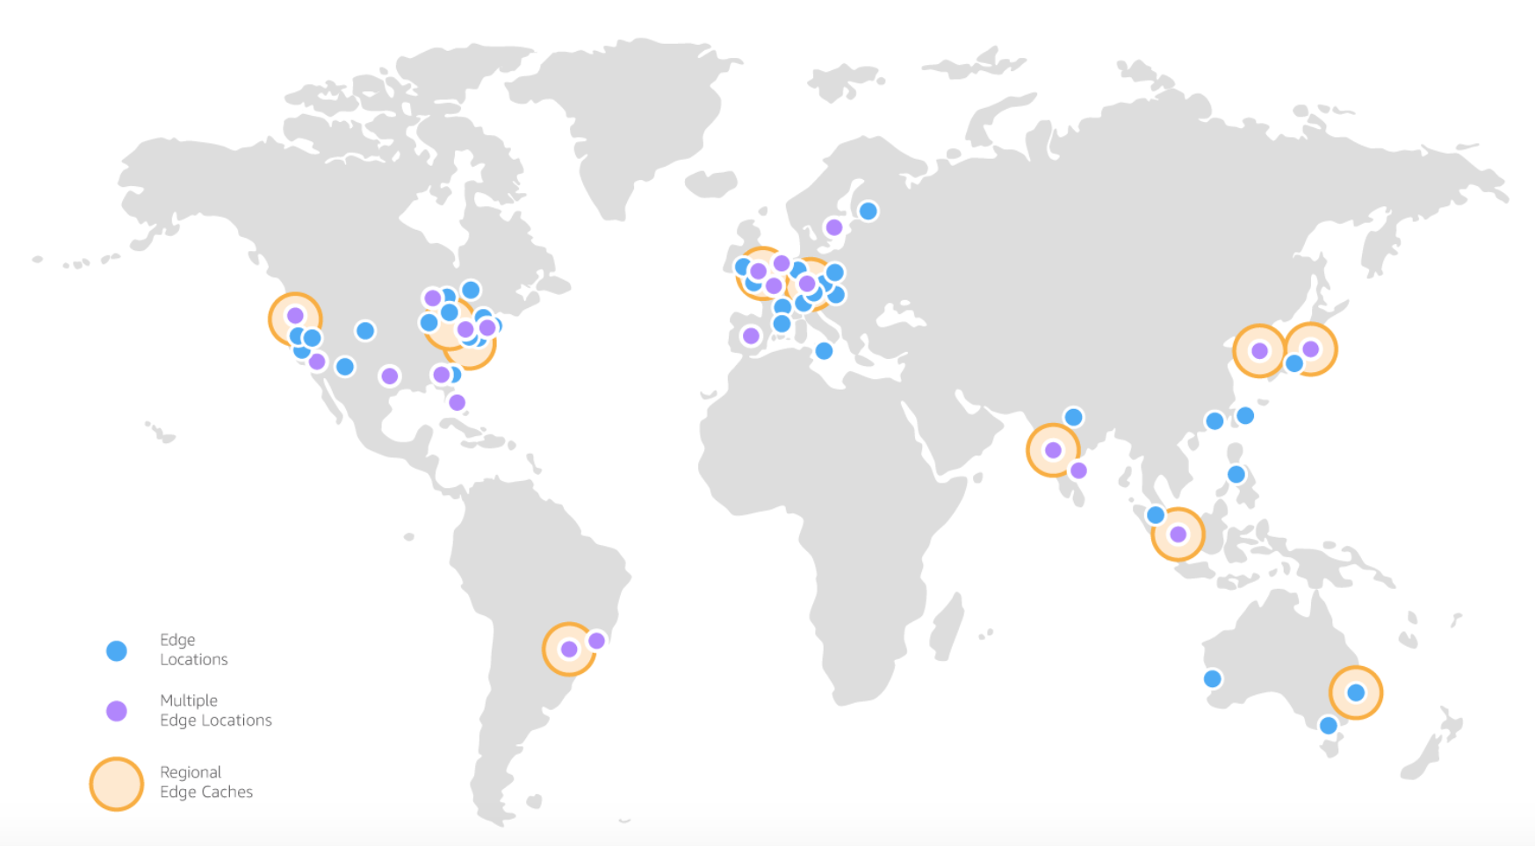
AWS Edge Locations
An Edge Location is where users access AWS services.
It is a global network of 114 points of presence (103 Edge Locations and 11 regional Edge Caches) in 56 cities across 24 countries.
Specifically used with Amazon CloudFront, a Global Content Delivery Network (CDN), to deliver content to end users with reduced latency.
Regional edge caches used for content with infrequent access.
Notes:
An Edge Location is where end users access AWS services.
It is a global network of 114 points of presence, with 103 Edge Locations and 11 regional Edge Caches in 56 cities, across 24 countries. They are located in most of the major cities around the world and serve requests for Amazon CloudFront and Amazon Route 53. Edge Locations are currently located in North America, Europe, Asia, Australia, and South America. AWS Edge locations offer CloudFront, Amazon Route 53, AWS Shield, and AWS Web Application Firewall (or WAF) services.
CloudFront is a Content Delivery Network (or CDN) used to distribute content to end users to reduce latency. Amazon Route 53 is a DNS service. Requests going to either one of these services will be routed to the nearest Edge Location automatically.
Regional Edge Caches, used by default with Amazon CloudFront, are utilized when you have content that is not accessed frequently enough to remain in an Edge Location. Regional Edge Caches absorb this content and provide an alternative to that content having to be fetched from the origin server.

Slide 12



AWS Infrastructure Features
Elastic and Scalable:
Elastic infrastructure; dynamic adaption of capacity
Scalable infrastructure; adapts to accommodate growth
Fault-tolerant:
Continues operating properly in the presence of a failure
Built-in redundancy of components
High availability:
High level of operational performance
Minimized downtime
No human intervention
Physically distinct
Backup generators
Data center
Data center
Data center
Data center
Data center
Data center
Data center
Data center
Availability Zone
Availability Zone
Network connectivity
Data center
Data center
Data center
Data center
Availability Zone
Uninterruptible power supply
Cooling equipment
AWS Region
Notes:
The AWS Cloud infrastructure is built around Regions and Availability Zones. AWS Regions provide multiple, physically separated, and isolated Availability Zones. An AWS Region contains two or more Availability Zones.
An Availability Zone is a data center or collection of data centers that are connected with low latency, high throughput, and highly redundant networking. Availability Zones are physically distinct and each has equipment like Uninterruptible Power Supplies, cooling equipment, backup generators, and security, to ensure uninterrupted operations.
This infrastructure has several valuable features:
First, it is elastic and scalable. This means resources can dynamically adjust to increases or decreases in capacity requirements. It can also rapidly adjust to accommodate growth.
Second, this infrastructure is fault tolerant, which means it has built-in component redundancy which enables it to continue operations despite a failed component.
Finally, it requires minimal to no human intervention, while providing high availability with minimal down time.

Slide 13
Part 2: AWS Service and Service Category Overview
Notes:
Introducing Part 2: AWS Service and Service Category Overview.
AWS offers a broad set of global cloud based products that can be used as building blocks for common cloud architectures. Let’s look at how these cloud based products are organized.

Slide 14
AWS Foundational Services
Applications
Virtual Desktops
Collaboration and Sharing
Databases
Analytics
App Services
Deployment and Management
Mobile Services
Cluster Computing
Queuing
Containers
Identity
Relational
Orchestration
Platform Services
Real-time
Dev/ops Tools
App Streaming
Sync
No SQL
Data Warehouse
Resource Templates
Transcoding
Mobile Analytics
Email
Usage Tracking
Caching
Data Workflows
Notifications
Search
Monitoring and Logs
Foundation
Services
Compute
(Virtual, Auto-scaling and Load Balancing)
Networking
Storage
(Object, Block and Archive)
Infrastructure
Regions
Availability Zones
Edge Locations
Notes:
As discussed previously, AWS’s global infrastructure can be broken down into three elements: Regions, Availability Zones, and Edge Locations. This infrastructure provides the platform for a broad set of services, such as networking, storage, compute power, and databases delivered as an on-demand utility that is available in seconds, with pay-as-you-go pricing.
Now, let’s shift our focus to the core services and take a more in-depth look at what these are and what each offers you for building your cloud solution.

Slide 15
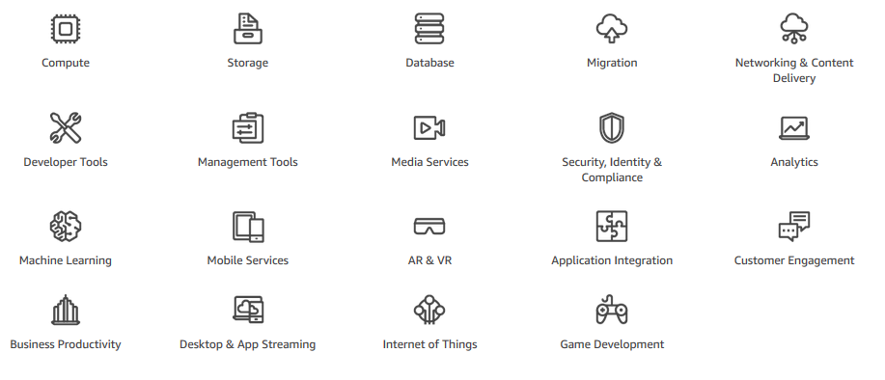
AWS Services and Categories
Notes:
AWS offers a broad set of global cloud-based services that can be used as building blocks for common cloud architectures. Some of the categories we will discuss in this module include Compute, Storage, Database, Networking & Content Delivery and Security, Identity & Compliance.
If you go to the AWS front page, aws.amazon.com, and scroll down to find the section that allows you to explore the products. It places all of the products and services into different categories. For example, click on Compute and you will see Amazon EC2 is first on the list. There are also a lot of other products and services that appear in the compute category.
If you click Amazon EC2, it brings you to the Amazon EC2 main page. Select the link to review. It gives you a detailed description of the product and lists some of the benefits. Additionally, there are links for Product Details, Instance Types, Pricing, Getting Started, FAQs, and Resources. When you click on Product Details there is more detailed information about Amazon EC2.
Explore the different service groups to understand the categories and services within them. Now that you know how to locate information about different services, let’s narrow our discussion to the AWS Core Services.

Slide 16


Section 1.0.3 Review:
Examined the AWS Global Infrastructure to understand:
Data Centers
Regions
Availability Zones
Edge Locations
Reviewed AWS service categories and their organization
To finish this module:
Complete:
Knowledge Assessment
Notes:
In summary, we examined the AWS Global Infrastructure to understand Data Centers, Regions, Availability Zones, and Edge Locations, and we reviewed different categories of AWS service categories and their organization.
To finish this module, please complete the corresponding knowledge assessment.

Slide 17
Up Next: Module 2 – AWS Core Services - Compute Introduction to Compute Services
Notes:
In Unit 2, we will look at the core of Amazon Web Services to better understand the specifics of each service. We will start in Module 2, Unit 1 with an introduction of compute services.

Slide 18
Thanks for participating!
© 2018 Amazon Web Services, Inc. or its affiliates. All rights reserved. This work may not be reproduced or redistributed, in whole or in part, without prior written permission from Amazon Web Services, Inc. Commercial copying, lending, or selling is prohibited. Corrections or feedback on the course, please email us at: aws-course-feedback@amazon.com. For all other questions, contact us at: https://aws.amazon.com/contact-us/aws-training/. All trademarks are the property of their owners.
Notes:
Thanks for participating!

